Slide 1
Startup Blueprint Generator Agent
CAPSTONE PROJECT
Presented By:
Arshia Bagchi-Thapar Institute of Engineering and Technology-Computer Engineering

Slide 2
OUTLINE
Problem Statement (Should not include solution)
Proposed System/Solution
System Development Approach (Technology Used)
Algorithm & Deployment
Result (Output Image)
Conclusion
Future Scope
References

Slide 3
Problem Statement
A Startup Blueprint Generator Agent, powered by RAG (Retrieval-Augmented Generation), transforms raw startup ideas into complete, actionable business blueprints. It retrieves relevant data on market research, funding options, competitor analysis, revenue models, government schemes, and legal requirements from startup portals, incubator databases, and policy documents. Users can describe their idea in simple terms, and the agent provides a structured plan including business model canvas, estimated budget, go-to-market strategy, and potential investor connections. The agent eliminates ambiguity and accelerates the journey from idea to implementation. This AI-driven assistant empowers aspiring entrepreneurs with clarity, resources, and direction to launch their ventures successfully

Slide 4
Proposed Solution
The proposed solution addresses the challenge of transforming vague startup ideas into structured, investor-ready blueprints. Using IBM watsonx.ai and Retrieval-Augmented Generation (RAG), the agent delivers intelligent, personalized startup planning support. The solution comprises the following components:
Input Understanding Users provide startup ideas in natural language. The agent identifies key themes (sector, goals, pain points) and infers missing context where needed.
Real-Time Information Retrieval Leveraging tools like Wikipedia Search (and optionally Google or Document Search), the agent pulls contextual data on market trends, competitors, funding schemes, and legal regulations to enrich its responses.
Blueprint Generation The agent synthesizes retrieved data to generate a complete startup plan, including: – Startup Summary – Unique value proposition – Market & competitor analysis – Target Users – Budget estimates – Legal/regulatory compliance – Go-to-market strategy – Investor and incubator suggestions
Tool Integration Retrieval tools for real-time grounding, and IBM watsonx.ai's built-in scalability for consistent deployment.
Deployment & Usability Hosted within IBM Cloud, the agent features a clean chat interface, configurable prompt instructions, and scalable backend support for real-time user interaction.

Slide 5
System Approach
The system leverages IBM watsonx.ai to build an AI-powered agent that converts user-submitted startup ideas into structured business blueprints using Retrieval-Augmented Generation (RAG). The approach includes:
System Requirements
IBM watsonx.ai Studio (cloud-based environment)
IBM Cloud account with access to Mistral foundation model
Internet connectivity for tool functionality
Tools and Libraries Used
Google Search Tool
DuckDuckGo Search Tool
Wikipedia Search Tool
No external Python libraries; all logic executed within watsonx built-in tools

Slide 6
Algorithm & Deployment
The agent uses IBM foundation models Mistral in a prompt-driven setup. Outputs are generated based on user input, internal reasoning, and tool-augmented retrieval.
Input Handling
Natural language startup idea from the user
Real-time data via Google Search, DuckDuckGo Search, Wikipedia Search,
Deployment Strategy
Built and deployed directly in IBM watsonx.ai Studio
No external libraries or training pipeline
Fully cloud-hosted with built-in scalability
Chat-based interface, usable via browser — no extra infrastructure needed

Slide 7
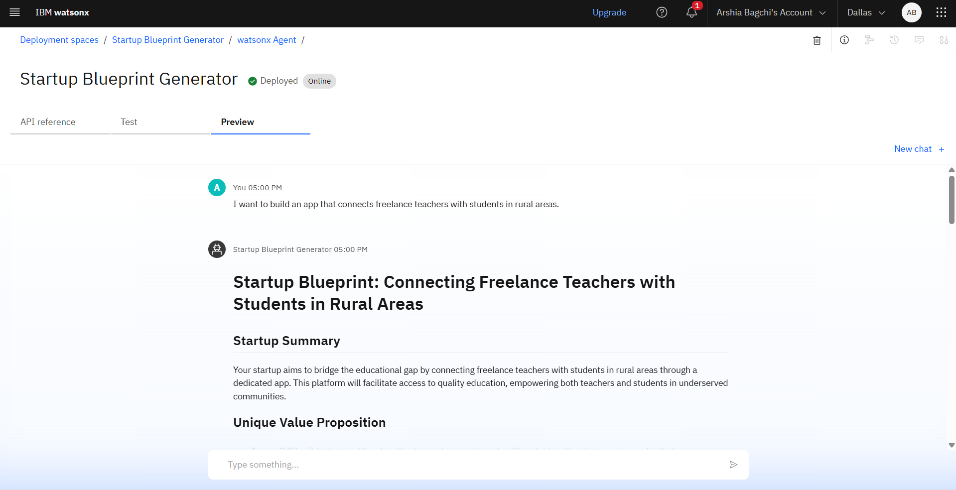
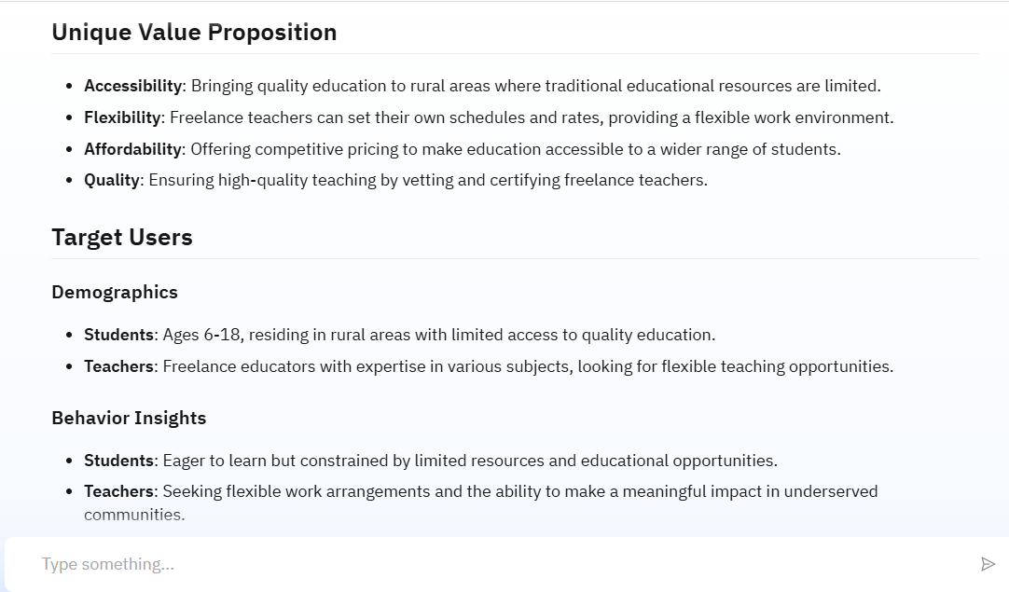
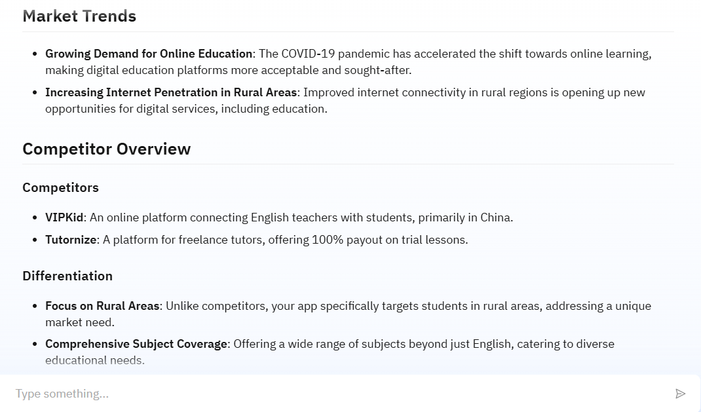
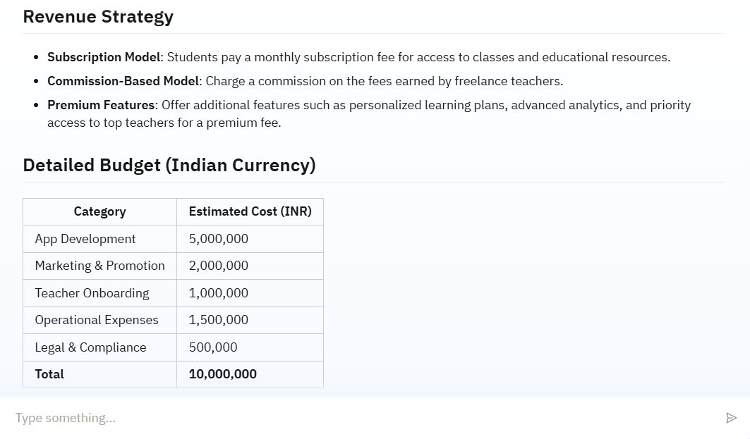
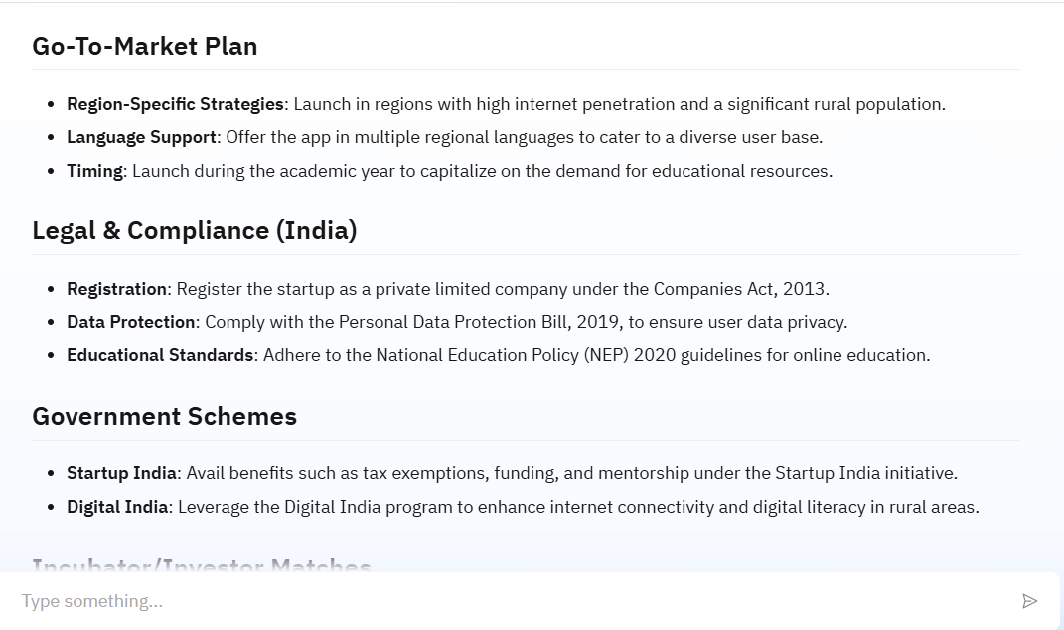
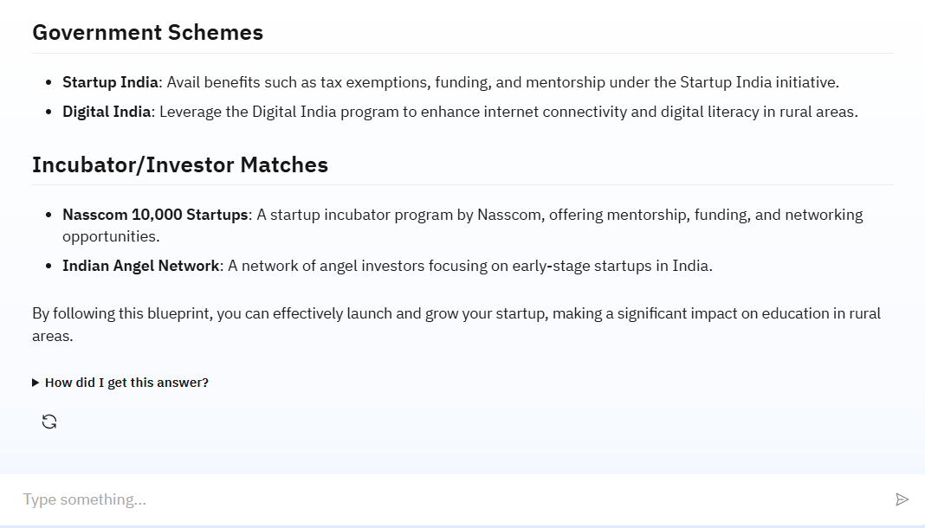
Result

Slide 8
Conclusion
The Startup Blueprint Generator Agent successfully demonstrates how IBM watsonx.ai can be leveraged to transform vague startup ideas into actionable, structured business plans using foundation models and retrieval tools. The agent offers a scalable, no-code solution that enables aspiring entrepreneurs to access market research, funding schemes, legal insights, and go-to-market strategies through a simple chat interface.
Key Takeaways:
Search tools made the agent’s responses more relevant and grounded in real context.
No custom model training or backend setup was needed — the prompt-driven system worked straight out of the box.
The chatbot interface makes it easy for users to get clear, actionable startup plans in real time.

Slide 9
Future scope
Expanded Data Integration
Add more retrieval tools like Google Search or custom startup policy documents
Integrate live databases for investors, incubators, and startup funding schemes
Agent Optimization
Fine-tune prompts to better handle niche or domain-specific startup ideas (e.g., biotech, climate tech)
Enable memory or context chaining for multi-turn refinement
Advanced Capabilities
Integrate with external APIs for real-time funding or legal updates
Explore RAG enhancements using private document ingestion
Optionally add basic analytics or visual tools to represent budget and market segments

Slide 10
References
IBM watsonx.ai Documentation https://www.ibm.com/docs/en/watsonx
Lewis, P. et al. (2020). Retrieval-Augmented Generation for Knowledge-Intensive NLP. NeurIPS. https://arxiv.org/abs/2005.11401
Osterwalder, A. & Pigneur, Y. (2010). Business Model Generation.
Framework source for structuring startup blueprints using Business Model Canvas.
Startup India Portal – Government Schemes & Support https://www.startupindia.gov.in
Central hub for Indian startup policies, schemes, and funding programs referenced by the agent.

Slide 11
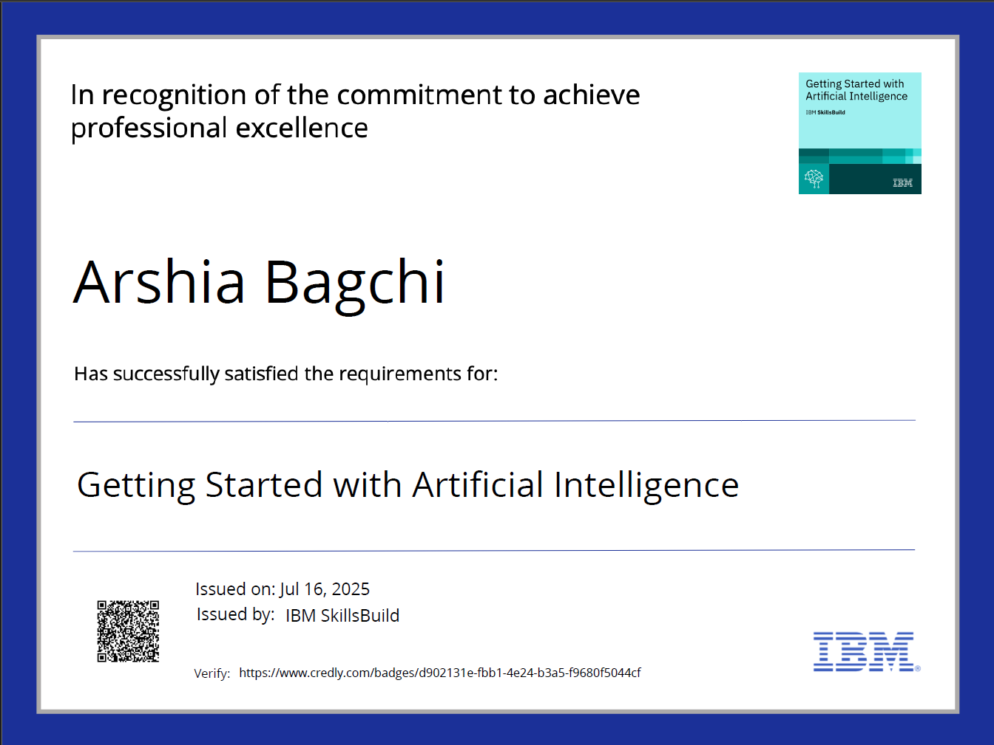
IBM Certifications

Slide 12
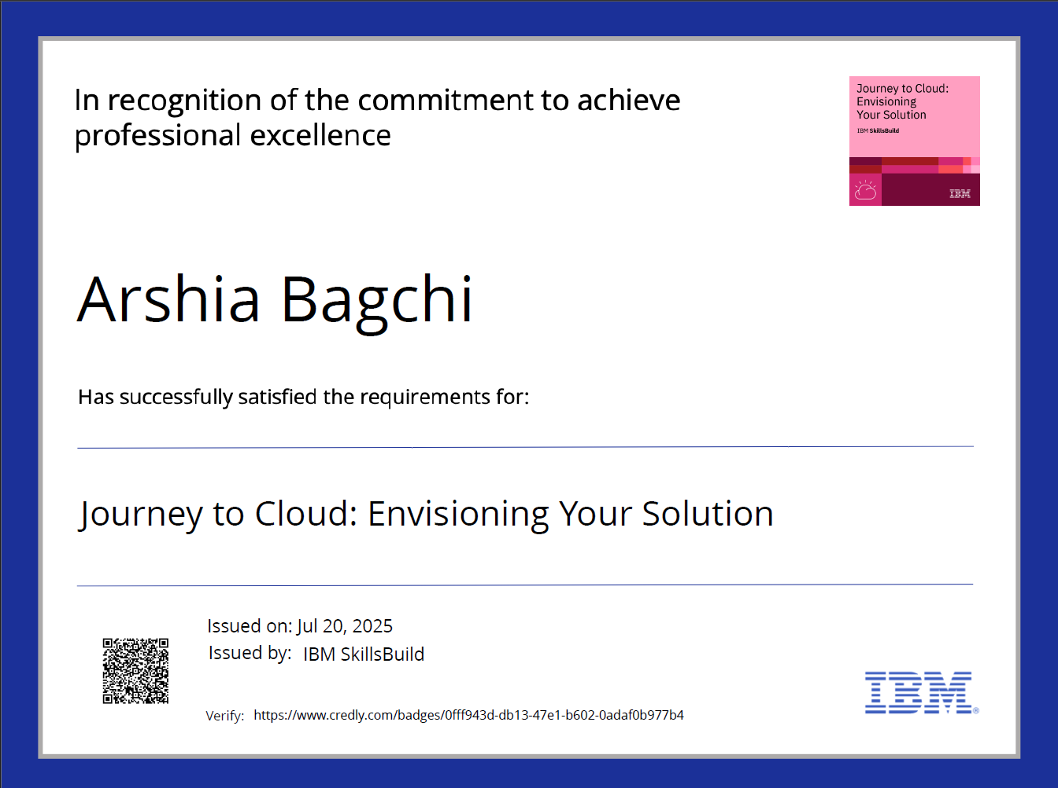
IBM Certifications

Slide 13
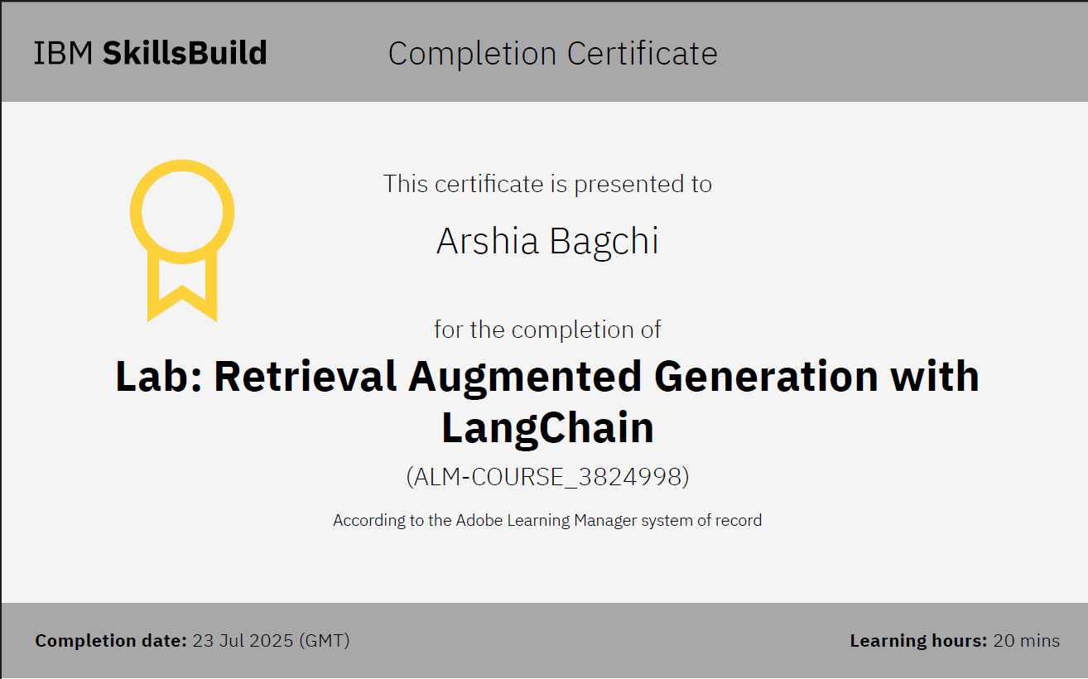
IBM Certifications

Slide 14
THANK YOU

